Slide 1
Responsive Web design
CSS3 and HTML5

Slide 2
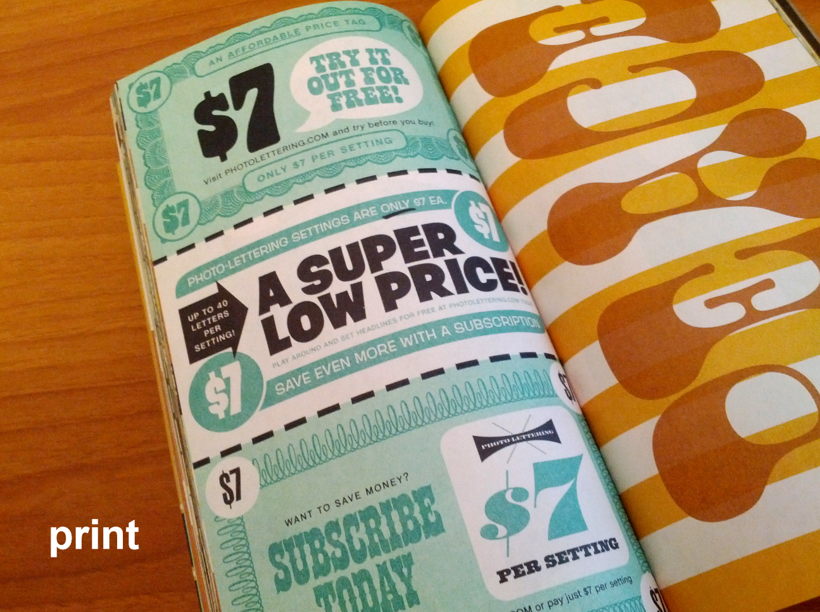
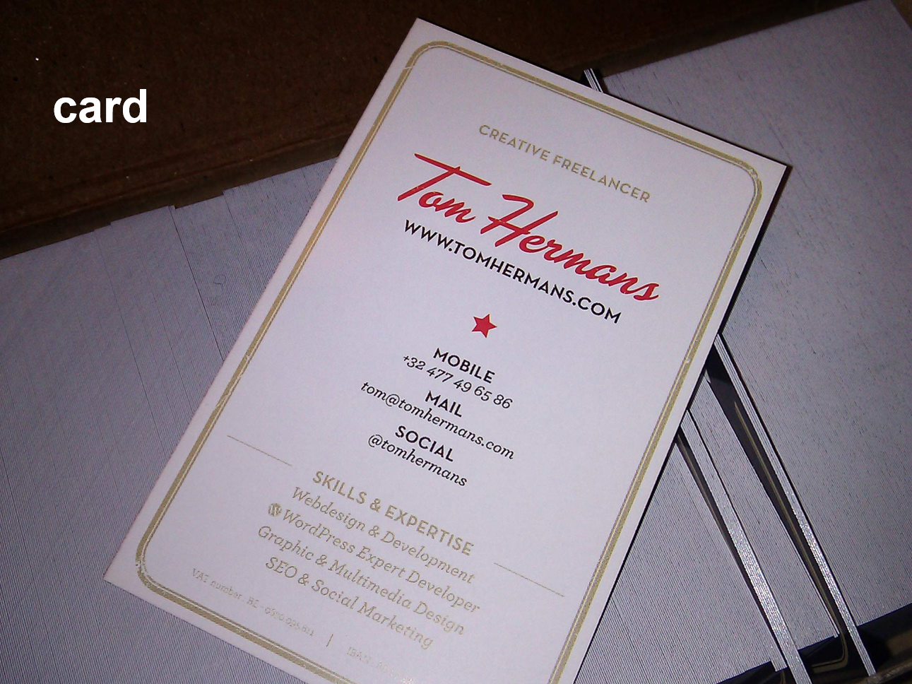
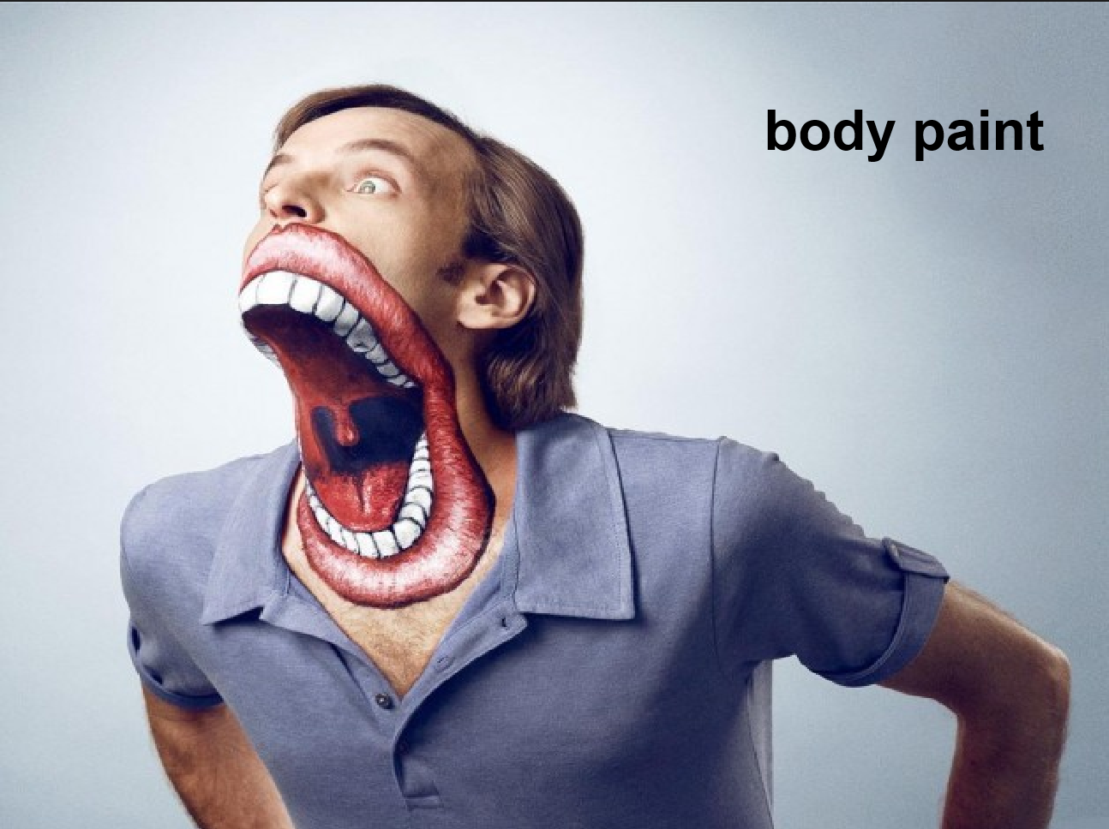
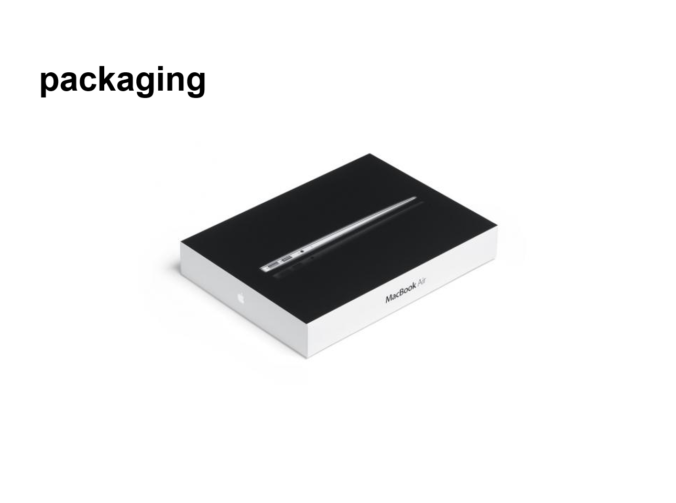
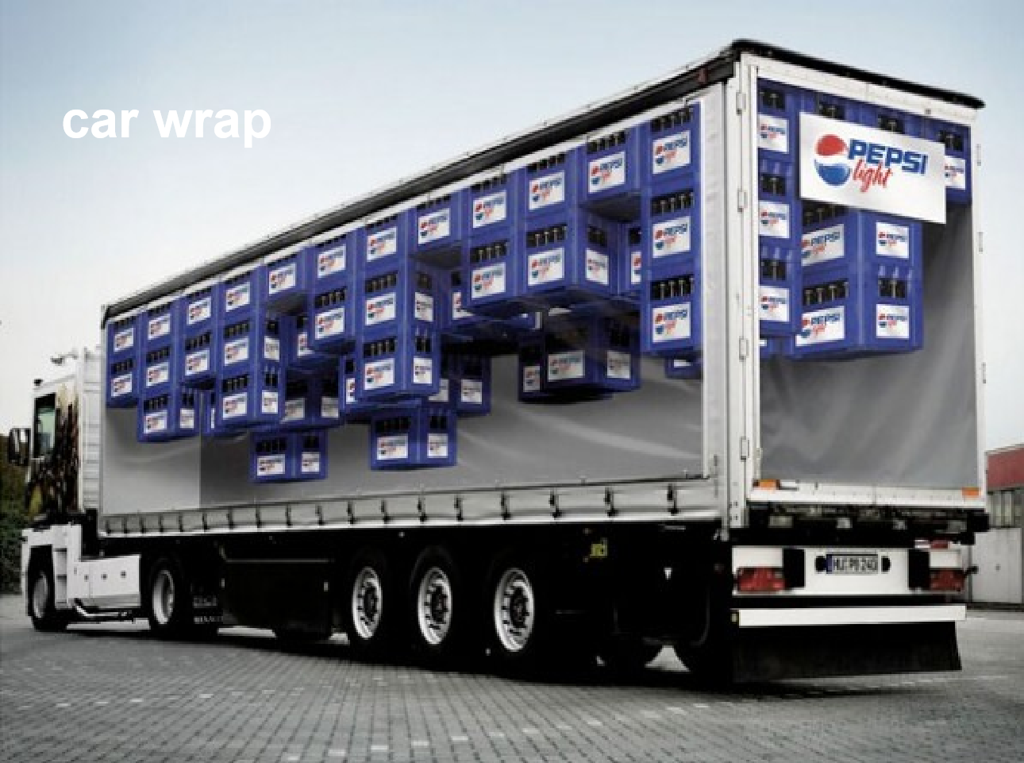

Traditional desing

Slide 3
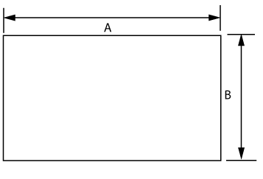
The common thing

Slide 4
The web

Slide 5
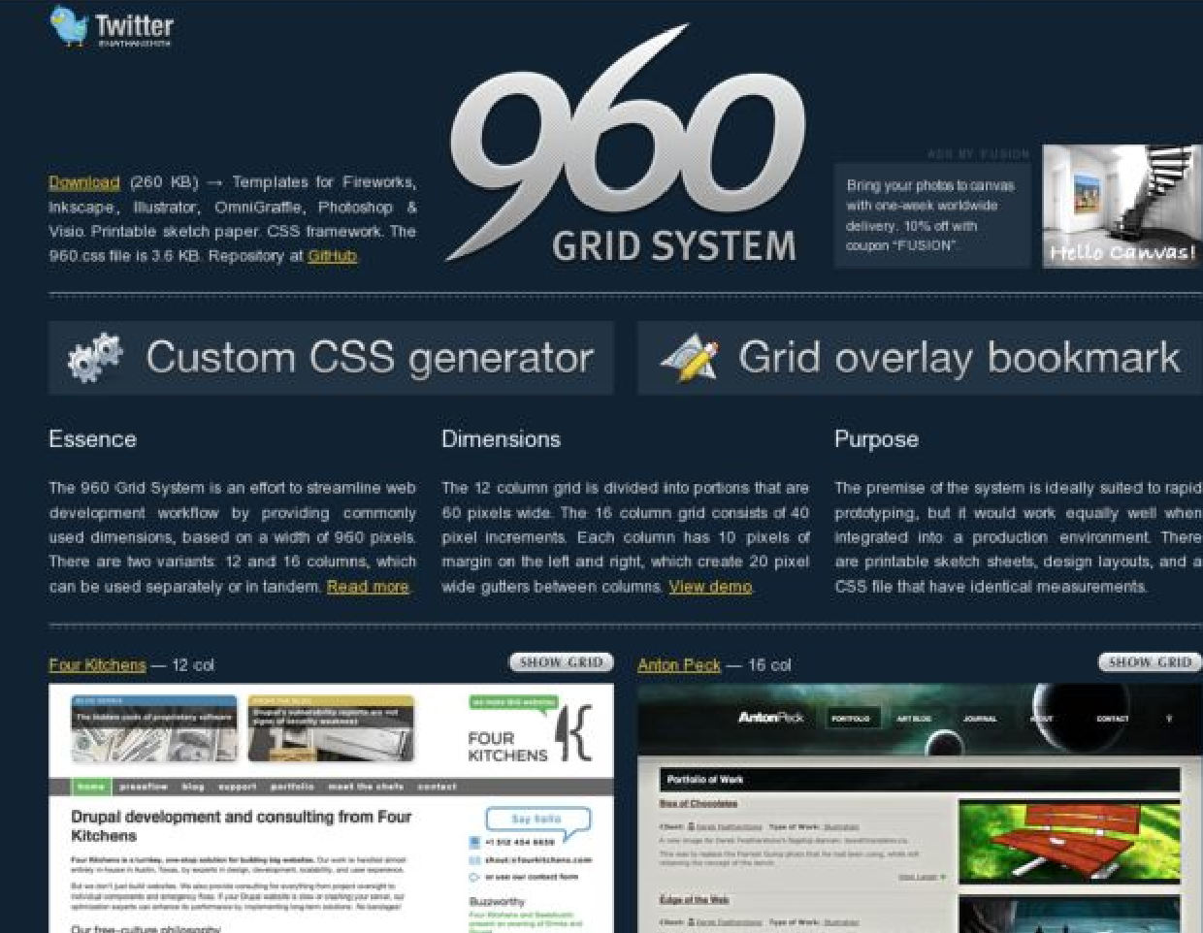
Does it make sense?

Slide 6

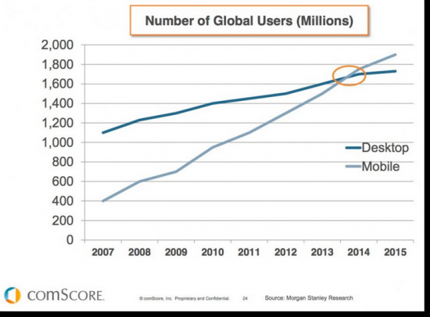
Why is important?

Slide 7
Solutions for mobile media consumption
native app
Tightly attached to an ecosystem.
Duplicated content with the web.
Only interesting if hardware access is required (e.g. graphics card, accelerometer) … and think of html5
No indexing
web app
Old embedded web browser with limited functionality
mobile website
m site vs www site
Duplicated content.
Wrong links to desktop webpages
responsive web design

Slide 8
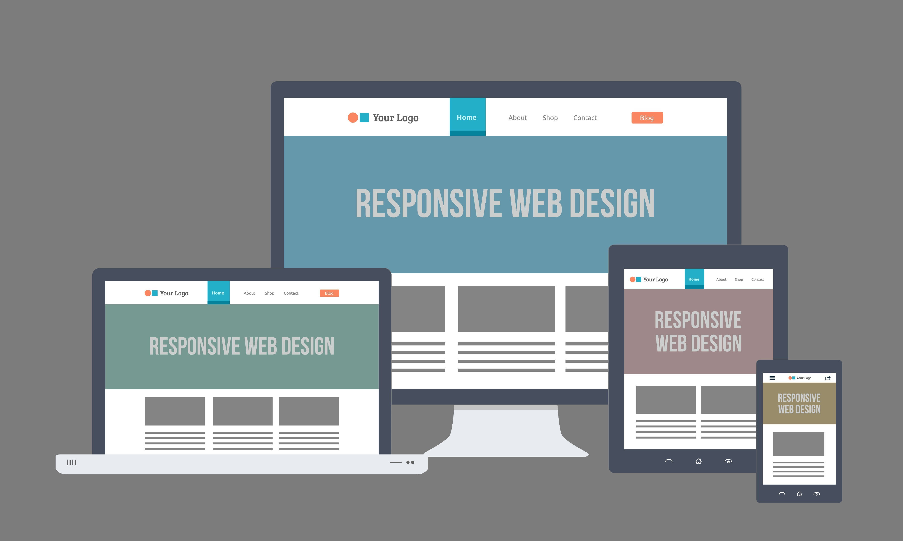
Web design nowadays…
What is Responsive Web Design?
Responsive Web Design makes your web page look good on all devices (desktops, tablets, and phones).
Responsive Web Design is about using CSS and HTML to resize, hide, shrink, enlarge, or move the content to make it look good on any screen
source:w3school

Slide 9
Benefits
A Single website
Same content distributed across different devices
A single url. Good for the SEO
A single codebase
Different functionality
Different layout

Slide 10
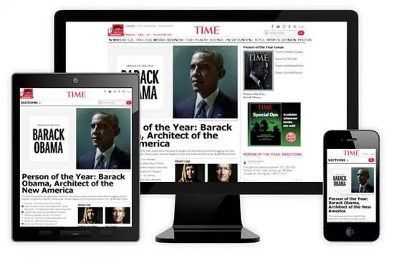
Example

Slide 11
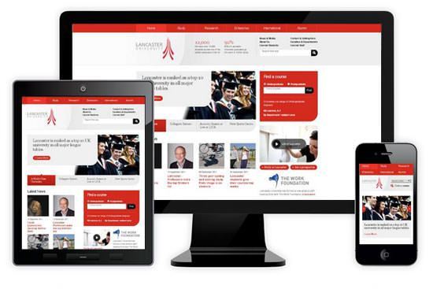
Example

Slide 12


Slide 13
Responsive design principles
Stop thinking in pixels
Think proportional
Think percentages
Think modular
Mobile first
Basic formatting to the page (type, colors, margins)
Media queries for bigger screens
Less capable browsers will always served a readable site

Slide 14
HTML5 - First things first
HTML v5 introduces mechanisms to dinamically know the visible part of a webpage.
Name is the name we assign to the element, viewport in this case.
With the content we state that the width of the page should be the same as the device-width. Will vary between a Tablet and a Smartphone.
With initial-scale=1.0 starts the visualization of the webpage with no zoom.
Do not forget to use “,” as separation to have full browser compatibility.

Slide 15
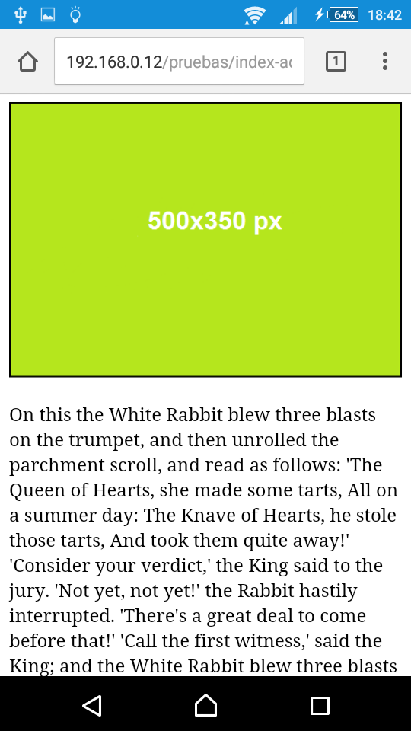
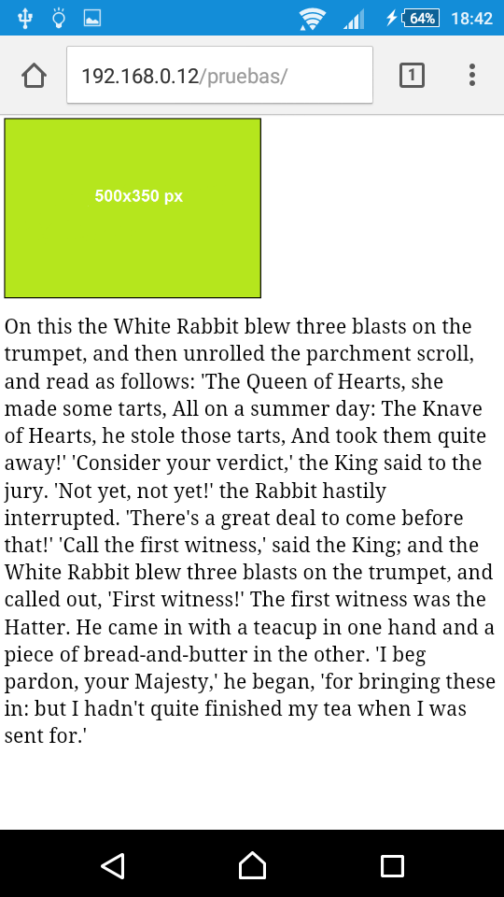
Example

Slide 16
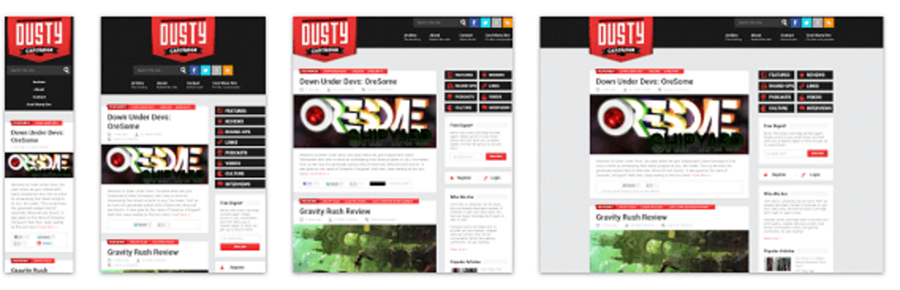
Fluid grids
What we need for this:
Box-sizing
A grid system
Media-queries

Slide 17
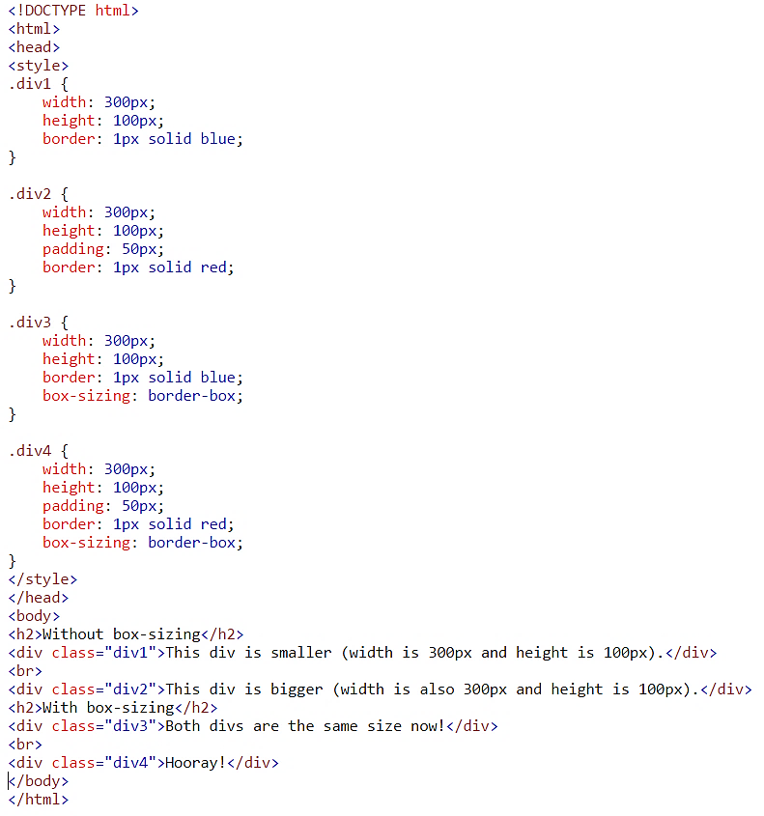
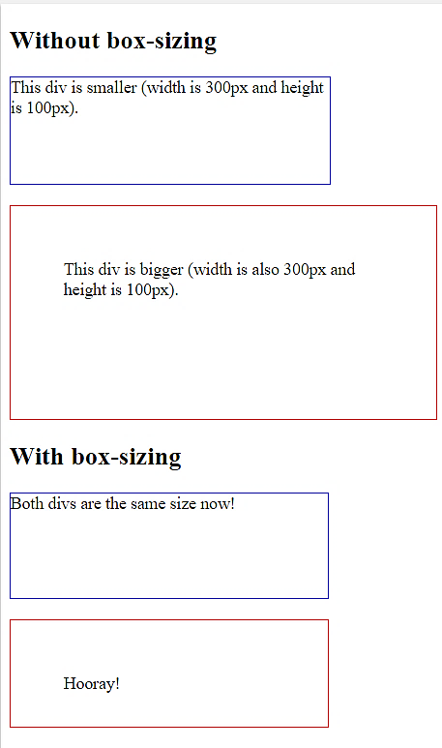
Box-Sizing: CSS3
http://www.w3schools.com/CSSref/css3_pr_box-sizing.asp
Por defecto el tamaño de un elemento es ancho+padding+borde para el ancho y alto+padding+borde para el alto, Box-sizing es una propiedad de CSS3 que permite incluir padding y bordes en el cálculo del tamaño total de un elemento.

Slide 18
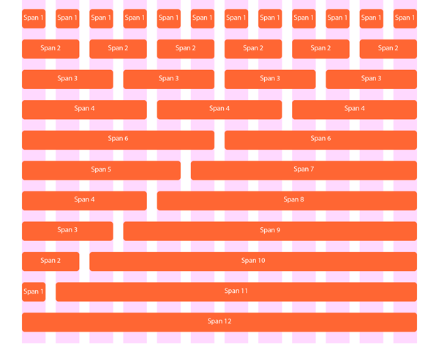
How to build up a grid system?

Slide 19
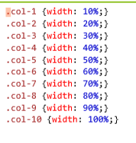

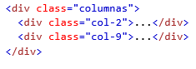
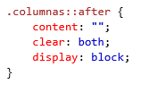
How to build up a grid system?
Divide the view-port in n equal columns
No more pixel-based divisions.
Traditionally, we divide in 10 or 12 columns
They should have the form
We need a container for all columns

Slide 20
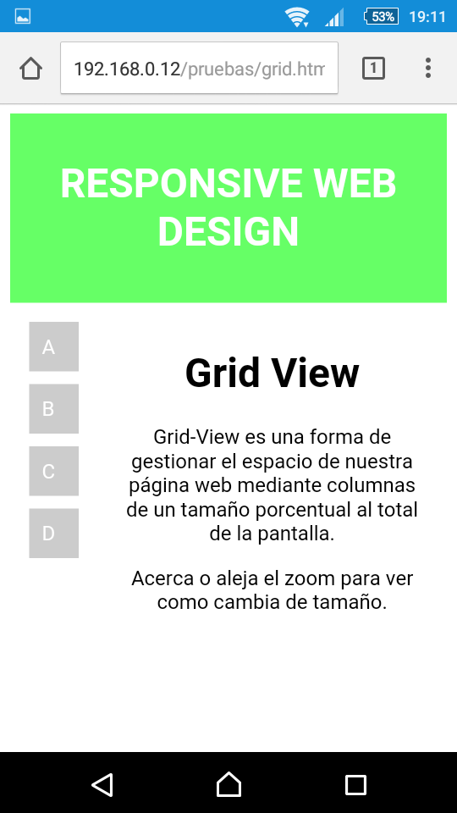
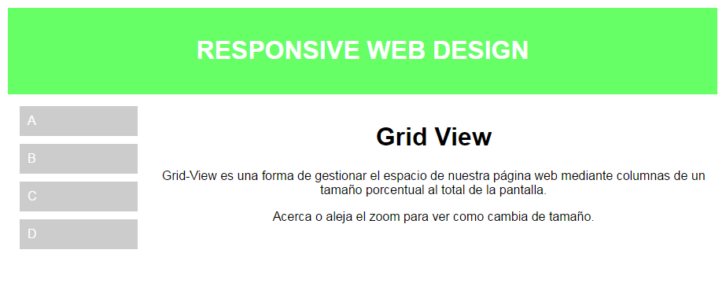
Example

Slide 21
Media Queries
The spirit of if-else
if media query test is met > css will be applied
common breakpoints: 320 480 600 768 960 1200
responsivepx.com ← for testing different viewport sizes

Slide 22
Media Queries
Mobile
Tablets
@media only screen and (min-width: 600px) {
Laptops
@media only screen and (min-width: 768px) {
[class*="col-"] {
float:left;
width: 100%;
}
.col-tab-1 {width: 10%;}
.col-tab-2 {width: 20%;}
.col-tab-3 {width: 30%;}
.col-tab-4 {width: 40%;}
.col-tab-5 {width: 50%;}
.col-tab-6 {width: 60%;}
.col-tab-7 {width: 70%;}
.col-tab-8 {width: 80%;}
.col-tab-9 {width: 90%;}
.col-tab-10 {width: 100%;}
}
.col-1 {width: 10%;}
.col-2 {width: 20%;}
.col-3 {width: 30%;}
.col-4 {width: 40%;}
.col-5 {width: 50%;}
.col-6 {width: 60%;}
.col-7 {width: 70%;}
.col-8 {width: 80%;}
.col-9 {width: 90%;}
.col-10 {width: 100%;}
}

Slide 23
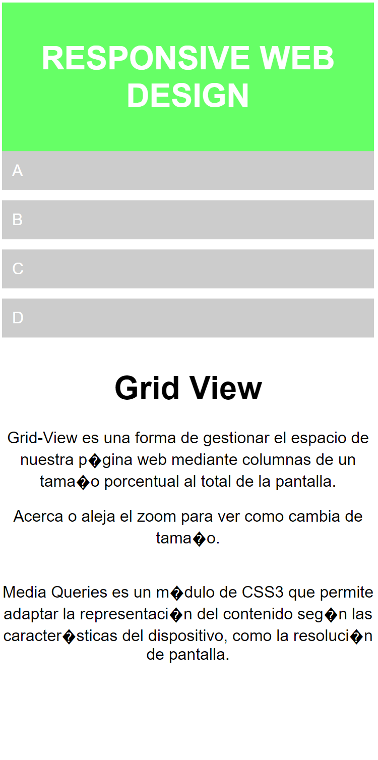
Media Queries
Mobile
Tablets
@media only screen and (min-width: 600px) {
Laptops
@media only screen and (min-width: 768px) {
[class*="col-"] {
float:left;
width: 100%;
}
.col-tab-1 {width: 10%;}
.col-tab-2 {width: 20%;}
.col-tab-3 {width: 30%;}
.col-tab-4 {width: 40%;}
.col-tab-5 {width: 50%;}
.col-tab-6 {width: 60%;}
.col-tab-7 {width: 70%;}
.col-tab-8 {width: 80%;}
.col-tab-9 {width: 90%;}
.col-tab-10 {width: 100%;}
}
.col-1 {width: 10%;}
.col-2 {width: 20%;}
.col-3 {width: 30%;}
.col-4 {width: 40%;}
.col-5 {width: 50%;}
.col-6 {width: 60%;}
.col-7 {width: 70%;}
.col-8 {width: 80%;}
.col-9 {width: 90%;}
.col-10 {width: 100%;}
}

Slide 24
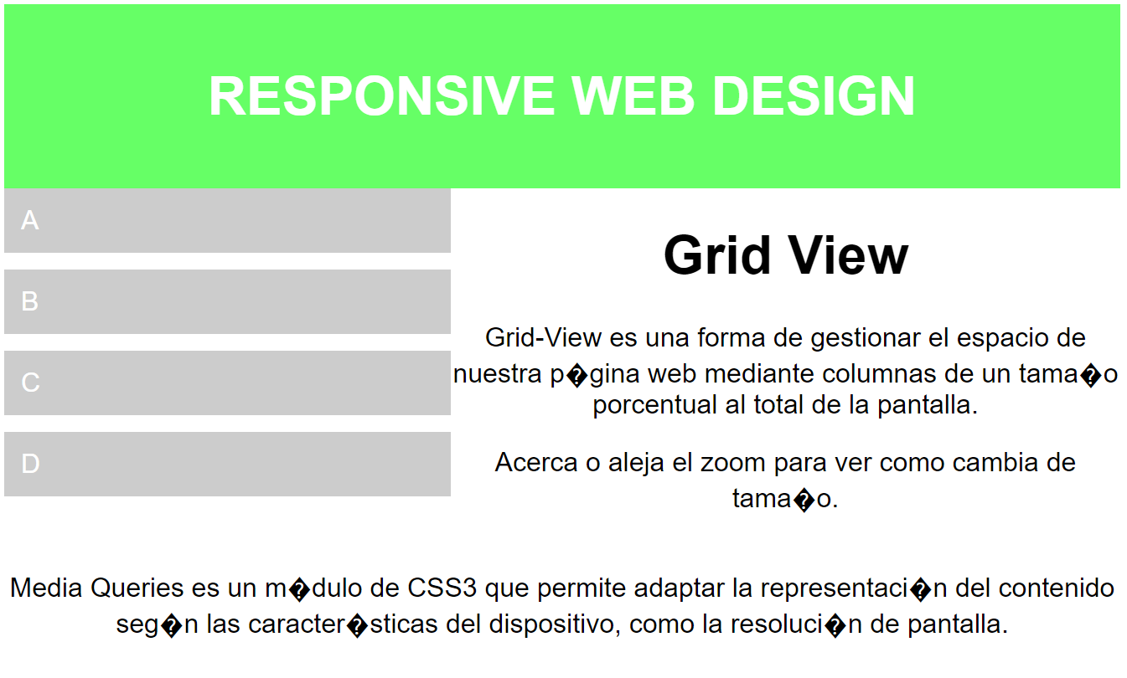
Media Queries
Mobile
Tablets
@media only screen and (min-width: 600px) {
Laptops
@media only screen and (min-width: 768px) {
[class*="col-"] {
float:left;
width: 100%;
}
.col-tab-1 {width: 10%;}
.col-tab-2 {width: 20%;}
.col-tab-3 {width: 30%;}
.col-tab-4 {width: 40%;}
.col-tab-5 {width: 50%;}
.col-tab-6 {width: 60%;}
.col-tab-7 {width: 70%;}
.col-tab-8 {width: 80%;}
.col-tab-9 {width: 90%;}
.col-tab-10 {width: 100%;}
}
.col-1 {width: 10%;}
.col-2 {width: 20%;}
.col-3 {width: 30%;}
.col-4 {width: 40%;}
.col-5 {width: 50%;}
.col-6 {width: 60%;}
.col-7 {width: 70%;}
.col-8 {width: 80%;}
.col-9 {width: 90%;}
.col-10 {width: 100%;}
}

Slide 25
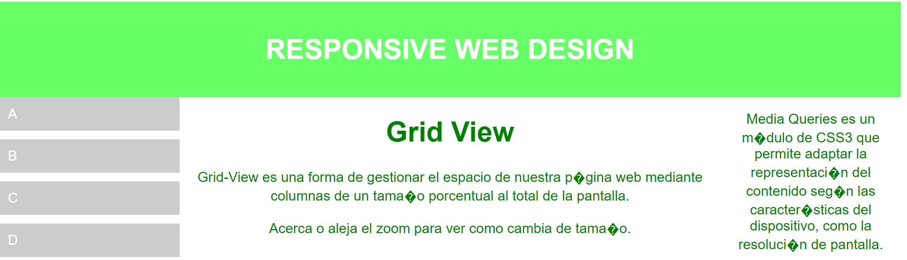
Media Queries
Mobile
Tablets
@media only screen and (min-width: 600px) {
Laptops
@media only screen and (min-width: 768px) {
[class*="col-"] {
float:left;
width: 100%;
}
.col-tab-1 {width: 10%;}
.col-tab-2 {width: 20%;}
.col-tab-3 {width: 30%;}
.col-tab-4 {width: 40%;}
.col-tab-5 {width: 50%;}
.col-tab-6 {width: 60%;}
.col-tab-7 {width: 70%;}
.col-tab-8 {width: 80%;}
.col-tab-9 {width: 90%;}
.col-tab-10 {width: 100%;}
}
.col-1 {width: 10%;}
.col-2 {width: 20%;}
.col-3 {width: 30%;}
.col-4 {width: 40%;}
.col-5 {width: 50%;}
.col-6 {width: 60%;}
.col-7 {width: 70%;}
.col-8 {width: 80%;}
.col-9 {width: 90%;}
.col-10 {width: 100%;}
}

Slide 26
Media Queries
Mobile
Tablets
@media only screen and (min-width: 600px) {
Laptops
@media only screen and (min-width: 768px) {
[class*="col-"] {
float:left;
width: 100%;
}
.col-tab-1 {width: 10%;}
.col-tab-2 {width: 20%;}
.col-tab-3 {width: 30%;}
.col-tab-4 {width: 40%;}
.col-tab-5 {width: 50%;}
.col-tab-6 {width: 60%;}
.col-tab-7 {width: 70%;}
.col-tab-8 {width: 80%;}
.col-tab-9 {width: 90%;}
.col-tab-10 {width: 100%;}
}
.col-1 {width: 10%;}
.col-2 {width: 20%;}
.col-3 {width: 30%;}
.col-4 {width: 40%;}
.col-5 {width: 50%;}
.col-6 {width: 60%;}
.col-7 {width: 70%;}
.col-8 {width: 80%;}
.col-9 {width: 90%;}
.col-10 {width: 100%;}
}

Slide 27
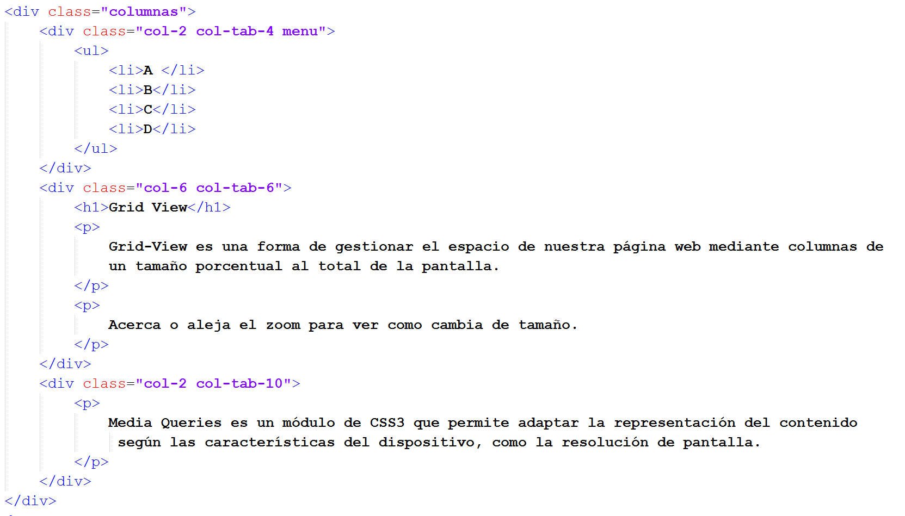
Media Queries

Slide 28
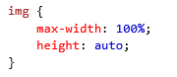
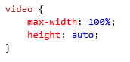
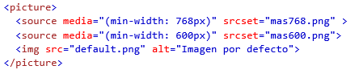
Images and video

Slide 29
Frameworks
Bootstrap 3
Foundation
Skeleton
…

Slide 30
Guidelines and conclussions
Los usuarios no deberían de tener que desplazarse de forma horizontal por la página o alejar el zoom si hay contenido demasiado ancho para mostrar por lo que deberemos añadir una serie de reglas adicionales a la hora de diseñar nuestra web adaptable.
Nunca usar elementos con un gran ancho de tipo fijo, en su lugar utilizar atributos como maxwidth:100% o height:auto.
El contenido no deberá estar optimizado para un cierto tipo de Viewport.
Usar CSS Media Queries para aplicar un estilo distinto en pantallas grandes o pequeñas.
De esta forma conseguiremos que el contenido se muestre correctamente sin importar desde donde estemos visualizando nuestra web.

Slide 31
Let’s do some execise!
https://jagalindo.github.io/issii-responsive-design/

